Slide 1

Retail Insights from Superstore Data
Student Name : Atshaya.S
AICTE ID : :APPLY_172728567366f449a94c7a7 Internship ID
COLLEGE : IFET college of Engineering

Slide 2

PROBLEM STATEMENT
This project is used to gain insights from superstore data by analyzing sales trends, customer behavior, product performance, and inventory management, ultimately providing actionable recommendations for business optimization and improved decision-making.
It solves the problem of understanding complex retail data to enhance operational efficiency and strategic planning.

Slide 3
Project Description [write detail description about your project ]
The "Retail Insights from Superstore Data" project involves an in-depth analysis of sales, profit, and customer data from a superstore.
By leveraging data analysis and visualization techniques, this project seeks to extract actionable insights that can support strategic decision-making in retail.
Key areas of focus include assessing sales and profitability by region and product category, identifying customer behavior trends, and pinpointing opportunities to improve operational efficiency. The project ultimately provides a framework for making data-backed decisions to boost sales, streamline operations, and improve customer satisfaction.

Slide 4

WHO ARE THE END USERS?
The end users include:
Retail Store Managers: To make informed decisions about product stocking and promotions.
Marketing Teams: To identify customer trends and target high-potential regions or demographics.
Supply Chain Managers: To streamline inventory management and reduce stockouts.
Business Analysts: For ongoing data insights and support for strategic planning.

Slide 5

Technology Used
Python: For data cleaning, transformation, and analysis.
Pandas & NumPy: Libraries for data manipulation and statistical analysis.
Matplotlib & Seaborn: Tools for data visualization.
Power BI/Tableau: For interactive dashboards, allowing users to explore sales and profit metrics.

Slide 6
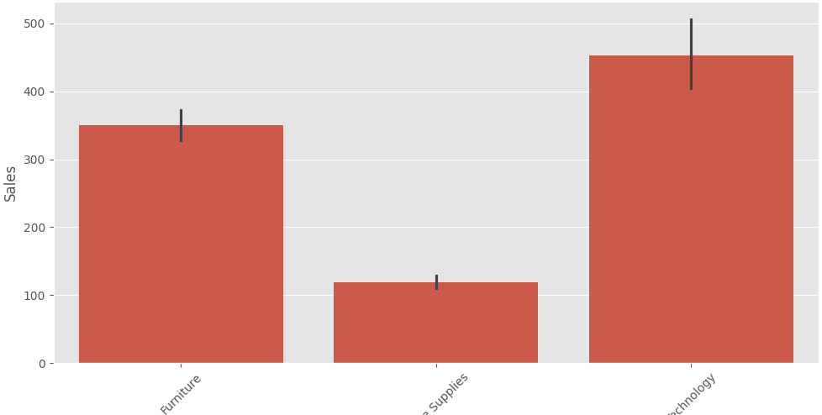
RESULTS
Sales by category :
Demo Link

Slide 7
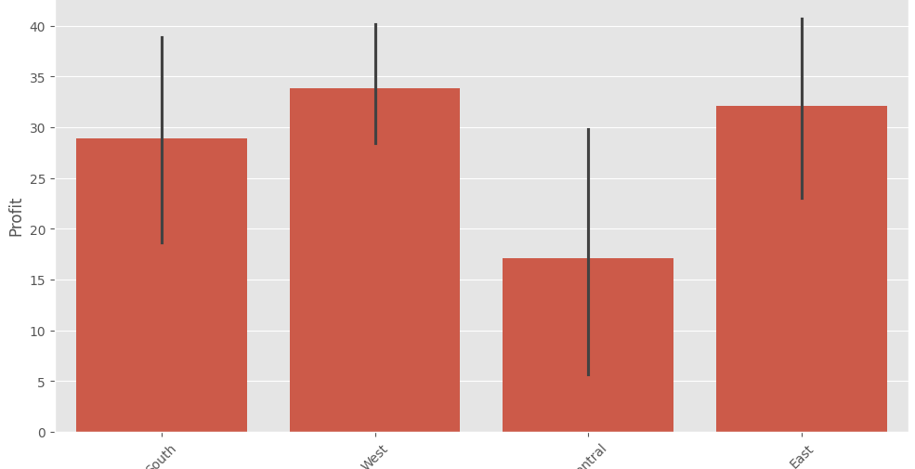
RESULTS
Profit by Region:
Demo Link

Slide 8
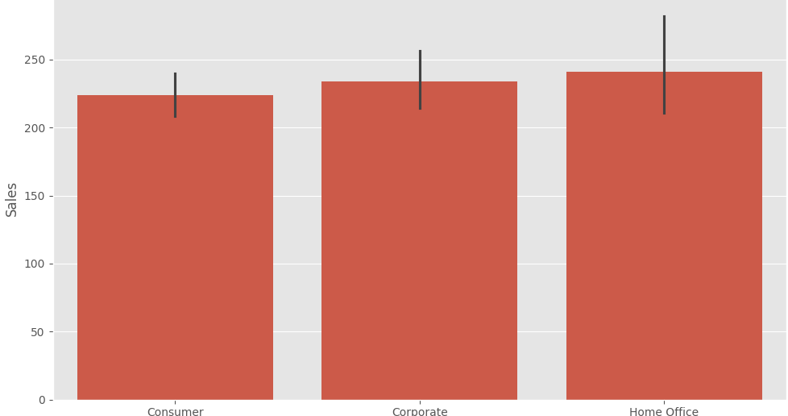
RESULTS
Sales by Customer Segment
Demo Link

Slide 9
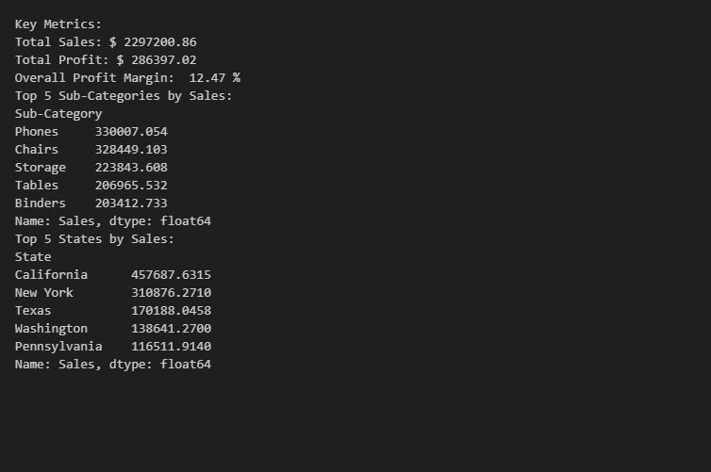
RESULTS
Demo Link

Slide 10
Thank you
Feel free to ask questions or provide feedback.
We appreciate your time and attention!
.
.

